Slide 1
Using Deep Reinforcement Learning for Autonomous Navigation

Slide 2
Autonomous Navigation
Autonomous navigation refers to the ability of an agent, such as a robot or vehicle, to plan and execute paths from a starting point to a destination using its own decision-making capabilities without any outside intervention
An autonomous navigation system basically involves sensing the environment, understanding its structure and making decisions to reach destinations while avoiding obstacles
The system must also handle uncertainties and changes in the environment in real time.

Slide 3
Autonomous Navigation
The problem of autonomous navigation is challenging due to dynamic obstacles, incomplete information and the complexity real-world environments.
Solutions to this problem require sophisticated algorithms that can sense the environment, generate feasible paths and efficiently adapt to unpredictable situations

Slide 4
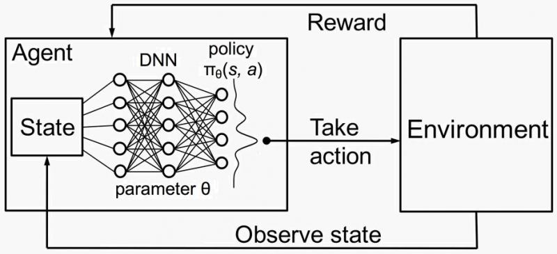
Autonomous Navigation
Deep reinforcement learning (DRL) has emerged as a promising approach for autonomous navigation by exploiting the ability to learn complex decision-making problems.

Slide 5
Deep Reinforcement Learning
DRL is a machine learning approach that combines Reinforcement Learning (RL) and Deep Learning (DL) to solve complex decision-making problems.
DRL enables an agent to learn optimal policies by interacting with its environment, receiving feedback in the form of rewards and using deep neural networks to handle high-dimensional input spaces.

Slide 6
Deep Reinforcement Learning
In studies, DRL is especially effective for tasks requiring adaptive behavior in dynamic and uncertain environments, such as robotics, gaming and autonomous systems.
Popular DRL algorithms include Deep Q-Networks (DQN), Proximal Policy Optimization (PPO) and Actor-Critic methods etc.

Slide 7
Aim of the work
By enabling agents to learn directly from their interactions with the environment, DRL provides a framework for developing adaptive and flexible navigation systems.
With algorithms such as DQN and PPO, machines can learn optimal navigation strategies, maximizing rewards while minimizing risks, even in high-dimensional and uncertain environments.

Slide 8
Aim of the work
This work aims to explore the application of deep reinforcement learning to autonomous navigation, investigating its potential to address real-world challenges and providing efficient, adaptive solutions.
By implementing and analyzing the DQN and PPO algorithms in the OpenAI Gym simulation environment, it aims to compare the success of deep reinforcement learning algorithms in the path-finding autonomous navigation problem.

Slide 9
Deep Q-Networks(DQN)
DQN is a reinforcement learning algorithm that uses deep neural networks to approximate the Q-value function and enables decision making in complex environments with high-dimensional state spaces.
It estimates the expected cumulative reward for taking an action in each state and then following the optimal policy.

Slide 10
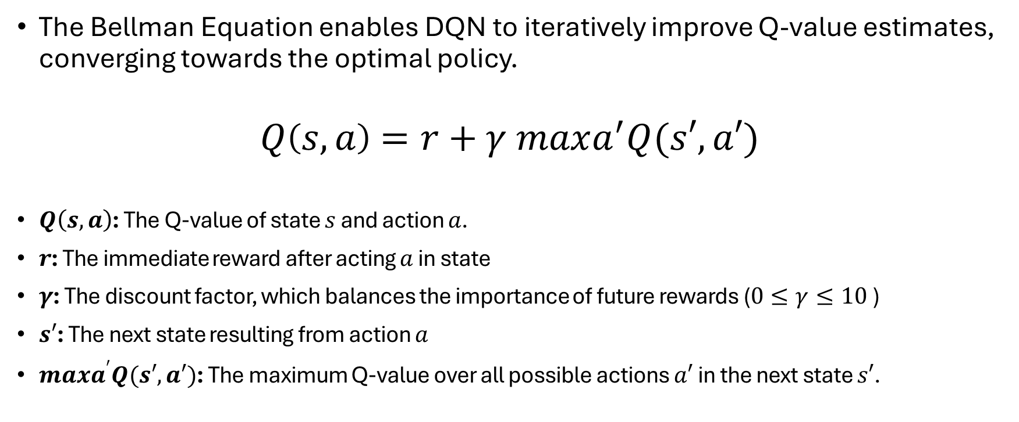
Bellman Equation
The Bellman Equation enables DQN to iteratively improve Q-value estimates, converging towards the optimal policy.
$$Q\left(s,a\right)=r+γ maxa^{′}​Q(s′,a′)$$
$Q\left(s,a\right)$: The Q-value of state $s$ and action $a$.
$r$: The immediate reward after acting $a$ in state
$γ$: The discount factor, which balances the importance of future rewards ($0≤γ≤10$)
$s′$: The next state resulting from action $a$
$maxa^{′}​Q(s′,a′)$: The maximum Q-value over all possible actions $a′$ in the next state $s′$.

Slide 11
Proximal Policy Optimization(PPO)
Proximal Policy Optimization (PPO) is a reinforcement learning algorithm that optimizes policies by balancing exploration and exploitation while maintaining stability and efficiency.
It uses a neural network to parameterize the policy and uses a surrogate objective function to iteratively improve the policy.
PPO imposes a constraint on the size of policy updates by trimming the likelihood ratio between new and old policies, ensuring that updates stay within a trust region.

Slide 12
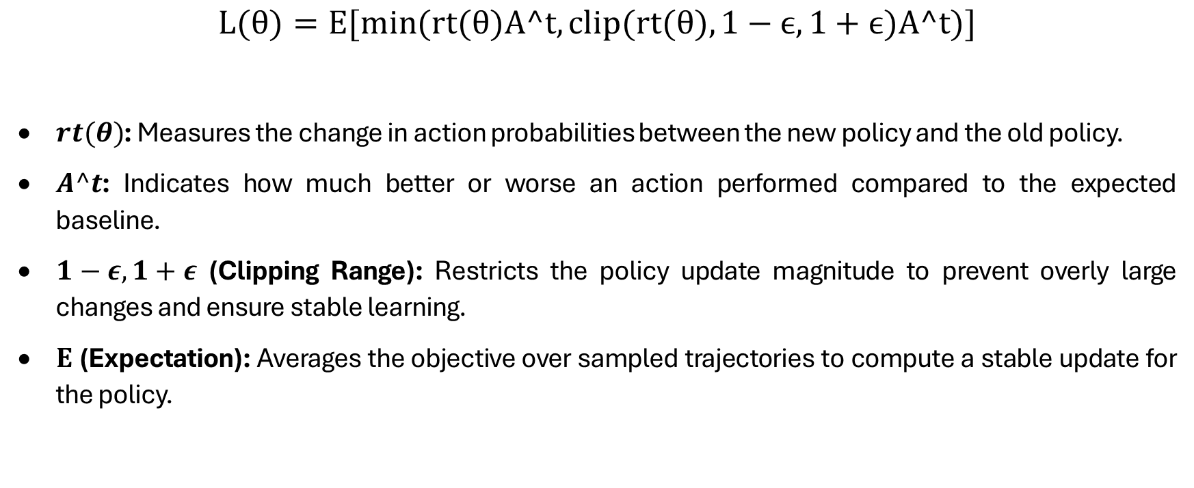
PPO Objective Function
$$L(θ)=E[min(rt​(θ)A^t​,clip(rt​(θ),1−ϵ,1+ϵ)A^t​)]$$
$rt​(θ)$: Measures the change in action probabilities between the new policy and the old policy.
$A^t$: Indicates how much better or worse an action performed compared to the expected baseline.
$1−ε,1+ε$ (Clipping Range): Restricts the policy update magnitude to prevent overly large changes and ensure stable learning.
$E$ (Expectation): Averages the objective over sampled trajectories to compute a stable update for the policy.

Slide 13
Software Specifications
In this study, the codes required to perform the experiments were written in Python.
Keras and Tensorflow libraries were used for model training.
OpenAI Gym environment was used for the simulation environment.

Slide 14
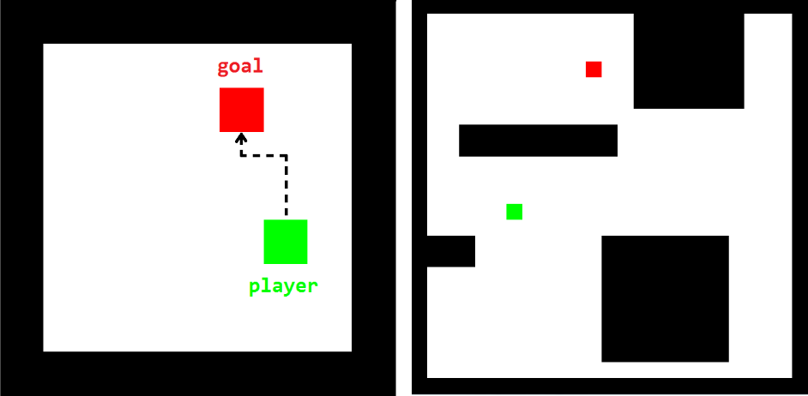
Simulation Environment
The chosen environment is a square grid with 25 rows and 25 columns, so there are 625 different states in the environment
4 available actions (up, down, left and right) for each state.
Target as a red square and the agent state as a green square.

Slide 15
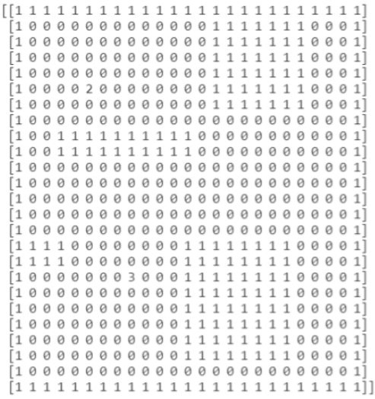
Environment State
Observation space: The free cells are represented by a 0, obstacles are 1, the agent is 2 and the target is 3.

Slide 16
DQN Implementation
Table 1. DQN Hyper-parameters
The network consists of an input layer matching the size of the flattened environment (625 neurons), one hidden layer with 32 neurons, and an output layer corresponding to the number of actions in the environment. The network uses tanh activation for hidden layers and a linear activation for the output layer. The agent trains the model with the Adam optimizer, minimizing the mean squared error (MSE) loss.
Hyper-parameters | Value
Episode count | 500
Step count | 2000
Learning rate | 0.001
Discount factor | 0.99
Memory size | 20000
Epsilon decay | 0.995
Exploration rate | 1 - 0.01

Slide 17
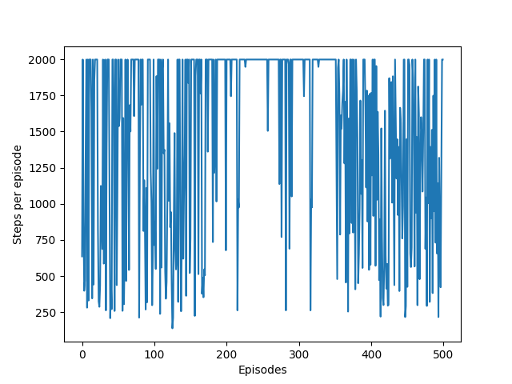
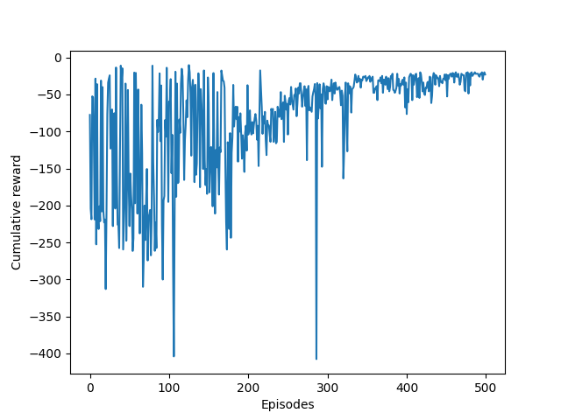
DQN episode/reward graph

Slide 18
DQN Results
DQN agent took 350 episodes to converge to its optimal policy, which allows the agent to reach the goal in 138 steps with a cumulative reward of 10.27 and a success rate of 51%. The DQN agent converges relatively slowly with a small success rate, taking approximately 8 hours to train.
Measure | Value
Maximum cumulative reward | 10.27
Convergence speed | 350 episodes
Success rate | %51
Number of actions of the optimal policy | 138
Training time | 493 minutes

Slide 19
PPO Implementation
In this implementation there is an agent with two separate neural networks: a policy network that outputs a probability distribution over actions (the actor) and a value network that estimates the expected payoff for a given state (the critic). Both networks have a hidden layer of 128 neurons using ReLU activation functions, while the output layers of the actor and critic use softmax activations. The models are optimized using the Adam optimizer with a learning rate of 0.001.
Hyper-parameters | Value
Episode count | 500
Step count | 2000
Learning rate | 0.001
Discount factor (gamma) | 0.99
Clip ratio | 0.2

Slide 20
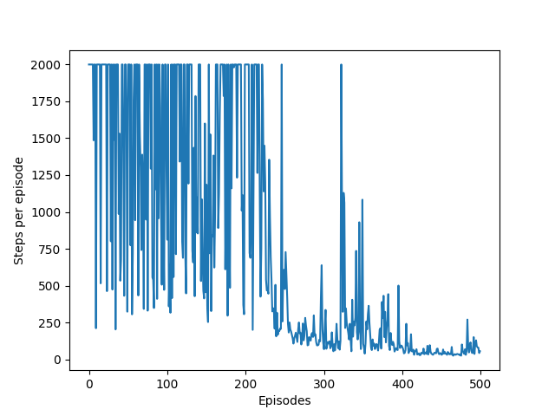
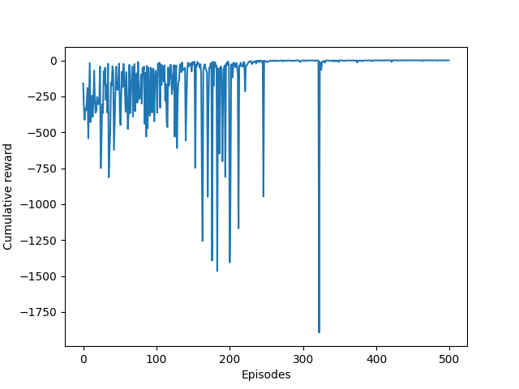
PPO episode/reward graph

Slide 21
PPO Results
PPO agent took the 250 episodes to converge to its optimal policy, which allows the agent to reach the goal in only 26 steps with a cumulative reward of 0.74 and a success rate of 76%. The PPO agent took about 41 minutes to train and successfully found the optimal path after 250 episodes
Measure | Value
Maximum cumulative reward | 0.74
Convergence speed | 250 episodes
Success rate | %76
Number of actions of the optimal policy | 26 actions
Training time | 41 minutes

Slide 22
Conclusion
This work aims to find a solution to the autonomous navigation of agents using reinforcement learning.
Within the scope of the study, DQN and PPO algorithms are implemented, and experimental results are shared.
To validate the algorithms used, simulations were designed and implemented in the Python based OpenAI Gym environment.
The designed algorithms are compared according to 3 main criteria: convergence speed, success rate and cumulative reward.
According to the experimental results, the graphs show that the PPO algorithm gives more successful results than the DQN algorithm.

Slide 23
THANK YOU

